Slide 1
Data Presentations (2)
Md. Ismail Hossain Riday

Slide 2
Important of graphs
Graphs are more attractive than tables of data
Make a clear impression in mind
A graph gives a bird’s eye view of the entire data
Easy comparison among two or more data sets
Easy to interpret

Slide 3
Limitations of graphs
Amount of details is reduced
We cannot always compute precise estimates of the data sets

Slide 4
Types of Graphs
Graphs for Quantitative data
Graphs for Qualitative data

Slide 5
Graphs for Quantitative
Common methods for graphically displaying quantitative data are
Histogram
Frequency polygon
Frequency curve
Ogive curve
Stem and Leaf plot

Slide 6
Histogram
Firstly, we need to create a frame work (that is, X axis and Y axis)
Mark the distinct class boundary value in X-axis
Mark the frequencies in the Y-axis
Draw a rectangle above each class whose height equals to the frequency of that class.
Label the axis.

Slide 7
Histogram
Hypothetical data set:
17, 8, 12, 19, 14, 6, 10, 15, 7, 18, 11, 16, 8
Construct the frequency distribution table.
Construct the histogram for the data.

Slide 8



Histogram
$$Y$$
Class | Tally | Frequency
5-9 | |||| | 4
9-13 | ||| | 3
13-17 | ||| | 3
17-21 | ||| | 3
5
4
3
2
1
$$0$$
$$X$$
5
9
13
17
21

Slide 9
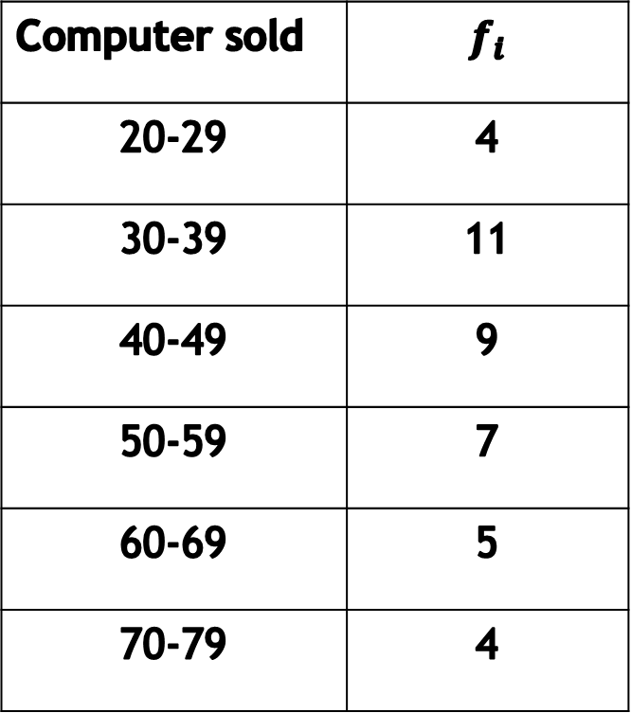
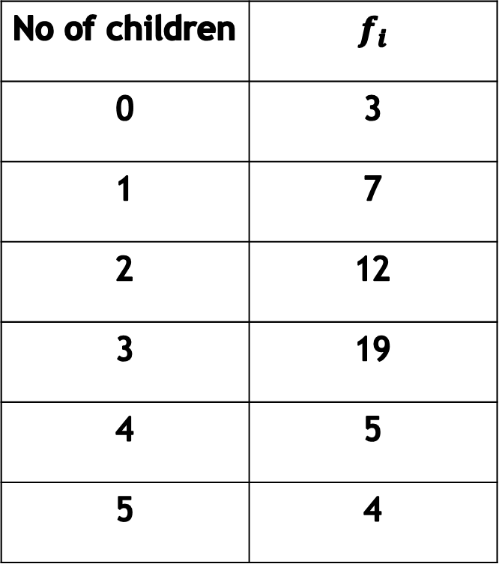
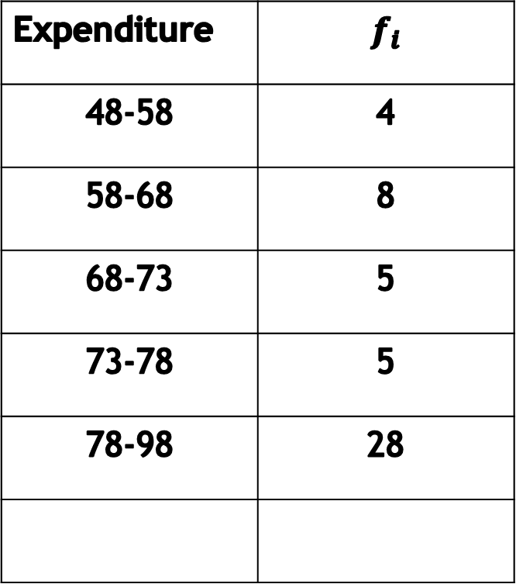
Histogram
Histogram for frequency
Histogram for Rel. Frequency
No of children | $$f_{i}$$
0 | 3
1 | 7
2 | 12
3 | 19
4 | 5
5 | 4
Computer sold | $$f_{i}$$
20-29 | 4
30-39 | 11
40-49 | 9
50-59 | 7
60-69 | 5
70-79 | 4
Expenditure | $$f_{i}$$
48-58 | 4
58-68 | 8
68-73 | 5
73-78 | 5
78-98 | 28

Slide 10
Frequency Polygon
Firstly, we need to create a frame work (that is, X axis and Y axis)
Mark the distinct class mid value in X-axis
Mark the frequencies in the Y-axis
Plot a point above each mid value at the height equal to the frequency of that class
Label the axis.

Slide 11
Frequency Polygon
Hypothetical data set:
17, 8, 12, 19, 14, 6, 10, 15, 7, 18, 11, 16, 8
Construct the frequency distribution table.
Construct the frequency polygon for the data.

Slide 12
Frequency Polygon
Class | Mid value | Frequency
5-9 | 7 | 4
9-13 | 11 | 3
13-17 | 13 | 3
17-21 | 19 | 3

Slide 13
Frequency Curve

Slide 14
Some points
The histogram is more often used when single distributions are presented.
The frequency polygon is largely used for comparison of two or more distribution.

Slide 15
Class work
Given below the frequency distributions of heights (in cm) of male and female students of CSE department of BRAC University.
Calculate relative frequency, cumulative frequency.
Draw comparative frequency polygon using frequency.
Draw comparative frequency polygon using Relative frequency.
Height | 105-115 | 115-125 | 125-135 | 135-145 | 145-155 | 155-165 | 165-175 | Total
Male | 5 | 6 | 8 | 19 | 10 | 7 | 5 | 60
Female | 7 | 10 | 18 | 8 | 6 | 2 | * | **
* Last digit of your ID; ** Sum of all female students

Slide 16
Ogive curve
Firstly, we need to create a frame work (that is, X axis and Y axis)
Mark the distinct class boundary in X-axis
Mark the cumulative frequency in the Y-axis
Plot a point above each upper boundary (for less than type) at a height equal to the cumulative frequency of that class
Label the axis

Slide 17
Ogive Curve
Hypothetical data set:
17, 8, 12, 19, 14, 6, 10, 15, 7, 18, 11, 16, 8
Construct the frequency distribution table.
Construct the ogive curve for the data.

Slide 18
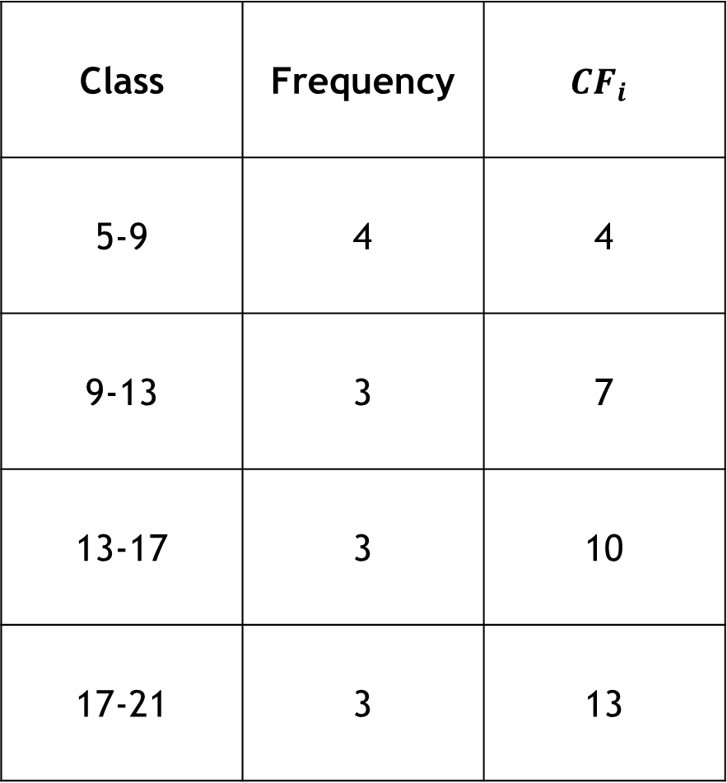
Ogive Curve
Less than type
Class | Frequency | $$CF_{i}$$
5-9 | 4 | 4
9-13 | 3 | 7
13-17 | 3 | 10
17-21 | 3 | 13

Slide 19
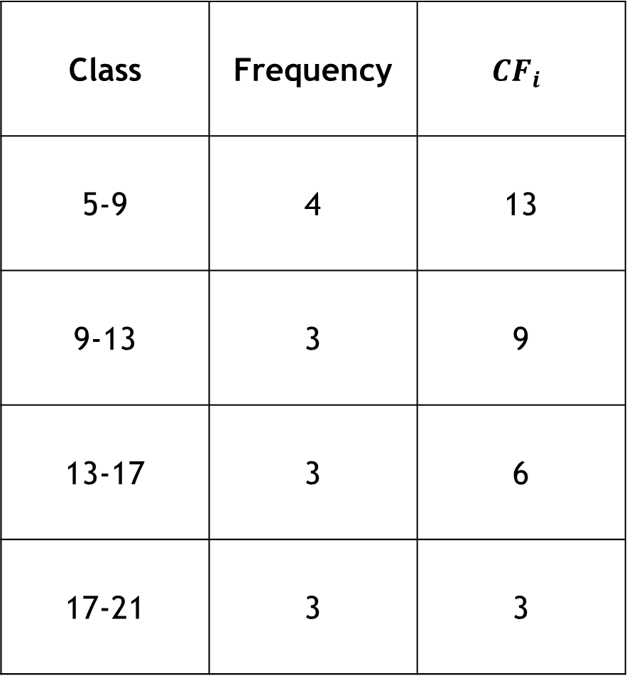
Ogive Curve
More than type
Class | Frequency | $$CF_{i}$$
5-9 | 4 | 13
9-13 | 3 | 9
13-17 | 3 | 6
17-21 | 3 | 3

Slide 20
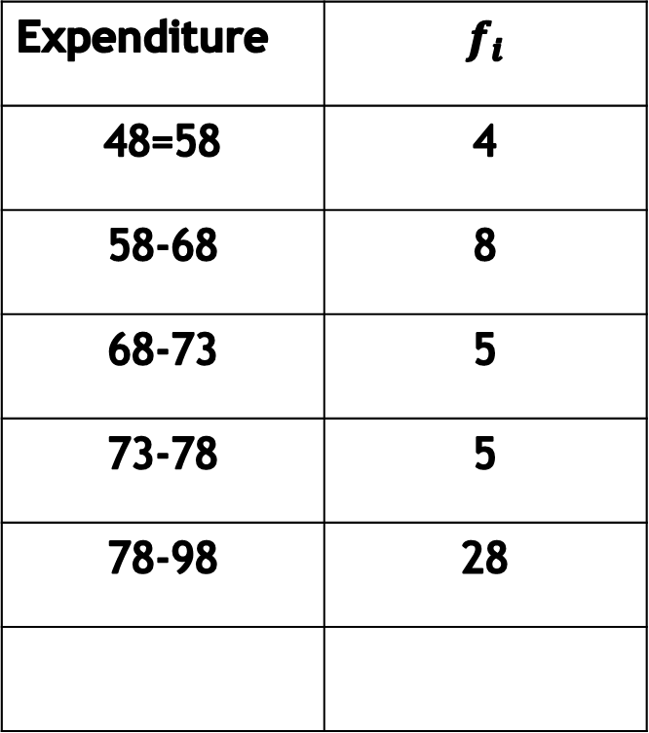
Exercise
Histogram, Frequency Polygon, Frequency Curve, Ogive Curve
No of children | $$f_{i}$$
0 | 3
1 | 7
2 | 12
3 | 19
4 | 5
5 | 4
Computer sold | $$f_{i}$$
20-29 | 4
30-39 | 11
40-49 | 9
50-59 | 7
60-69 | 5
70-79 | 4
Expenditure | $$f_{i}$$
48=58 | 4
58-68 | 8
68-73 | 5
73-78 | 5
78-98 | 28

Slide 21

Stem and Leaf plot
The stem and leaf plot is a simple device to construct a histogram-like picture of a frequency distribution.
84
Stem=8
Leaf=4
Stem
Leaf

Slide 22
Stem and Leaf
Hypothetical data set:
12, 23, 19, 6, 10, 7, 15, 25, 21, 12
Construct the stem and leaf for the data.
0 1 2 | 67 29052 351
0 1 2 | 67 02259 135

Slide 23
Graphs for Qualitative
Common methods for graphically displaying quantitative data are
Bar Chart
Pie Chart

Slide 24
Bar Chart
Blood type | Frequency | Relative frequency
O | 14 | 14/40=0.35
A | 10 | 10/40=0.25
B | 10 | 0.25
AB | 6 | 0.15
Total | 40 | 1.00

Slide 25

Pie Chart
$$Slice size=360×RF$$
Blood type | Frequency | Relative frequency
O | 14 | 14/40=0.35
A | 10 | 10/40=0.25
B | 10 | 0.25
AB | 6 | 0.15
Total | 40 | 1.00

Slide 26
Class work
 | Eye Condition
Gender | Near Sighted | Far Sighted | Need Bifocals
Male | 12 | 40 | 12
Female | 12 | 48 | 36
Bar chart of gender by Eye condition
Bar chart of eye condition by gender

Slide 27
Bar chart vs Histogram
Histogram refers to a graphical representation; that displays data by way of bars to show the frequency of numerical data.
A bar graph is a pictorial representation of data that uses bars to compare different categories of data.

Slide 28
Mathematical exercise
To access additional mathematical problems, please refer to the PDF lecture notes.

Slide 29
Thank You

